Slide 1

WAY TO ENTERPRISE
Spring Framework

Slide 2
Agenda
ModelMapper
Specification
HATEOAS
Assignments
Copyright © VTI Academy All Rights Reserved

Slide 3
ModelMapper
Used to automatically convert objects
Home page: http://modelmapper.org/

Slide 4
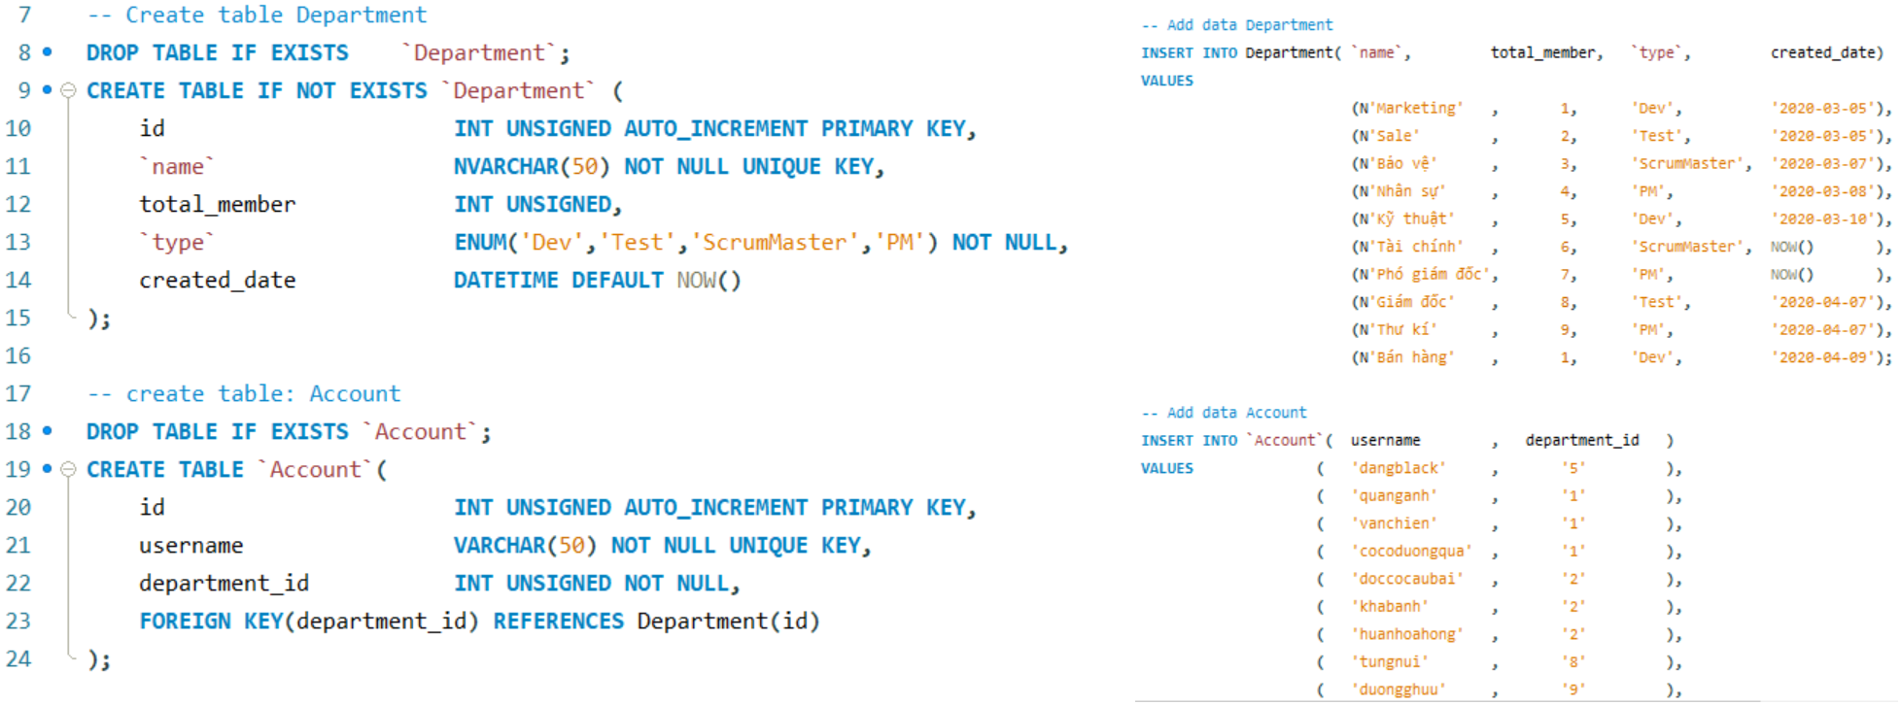
ModelMapper
Example
  Repeat error

Slide 5
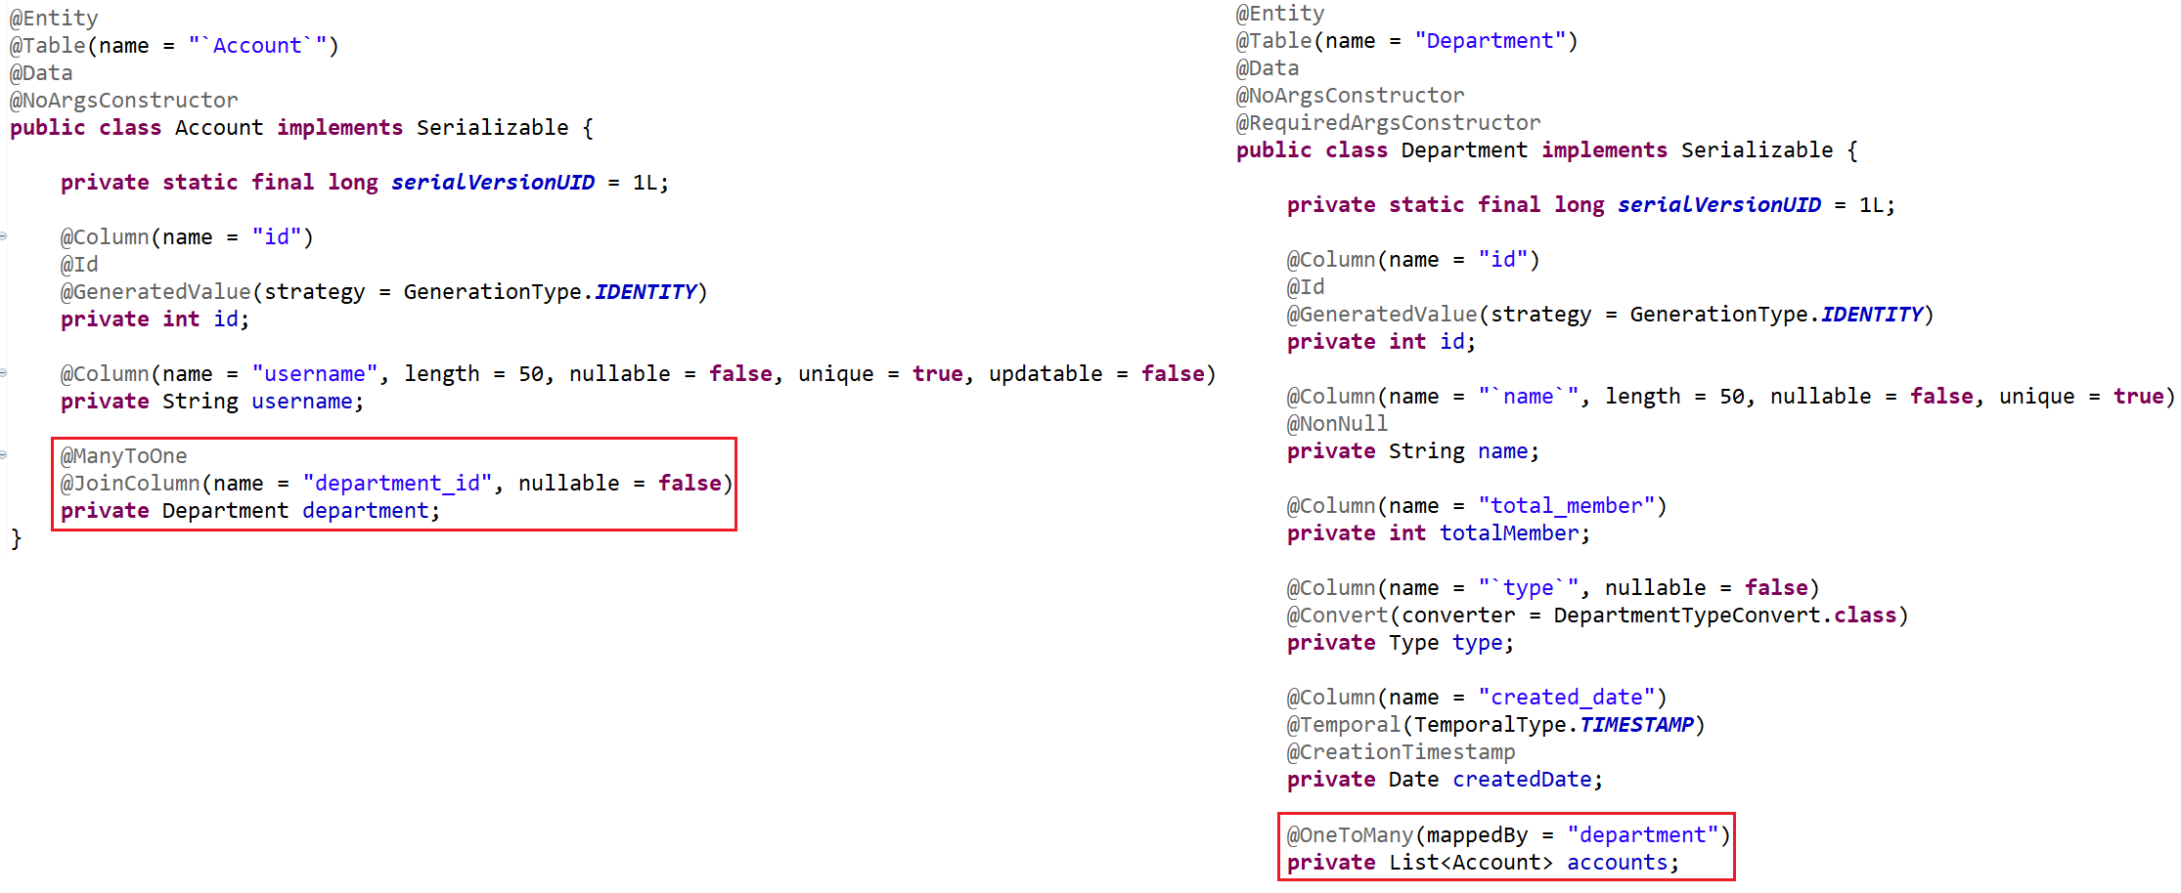
ModelMapper
Entity

Slide 6
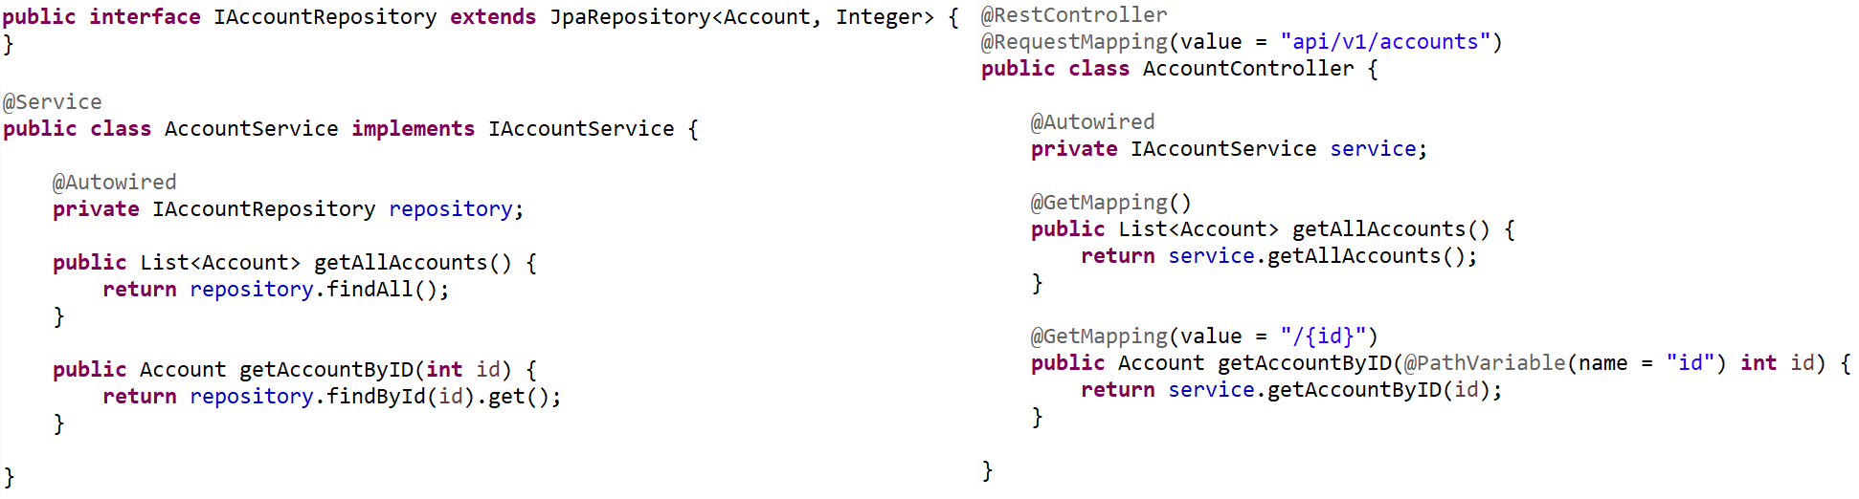
ModelMapper
Repository & Service & Controller

Slide 7
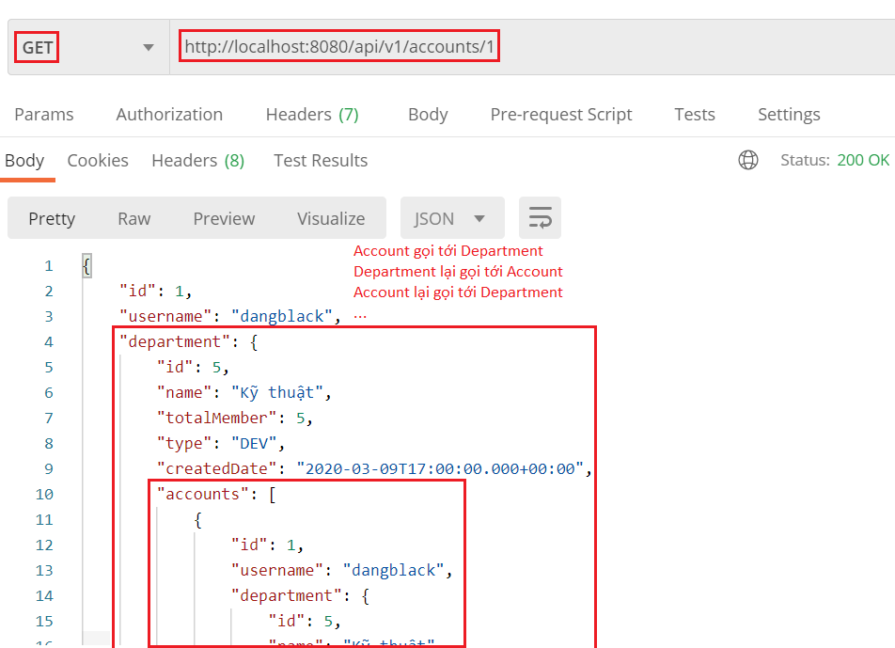
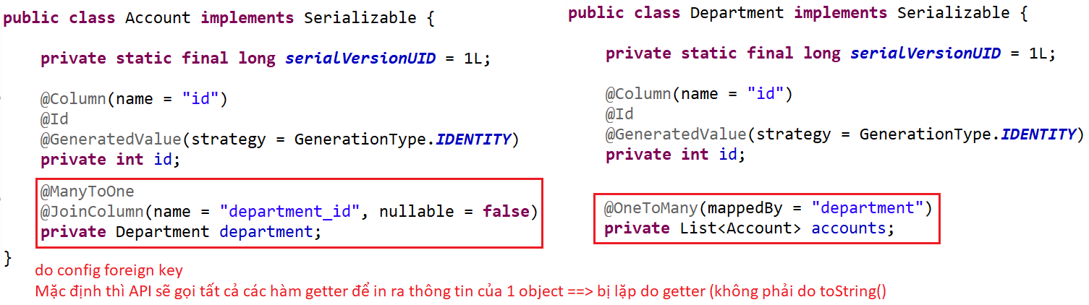
ModelMapper
Test

Slide 8
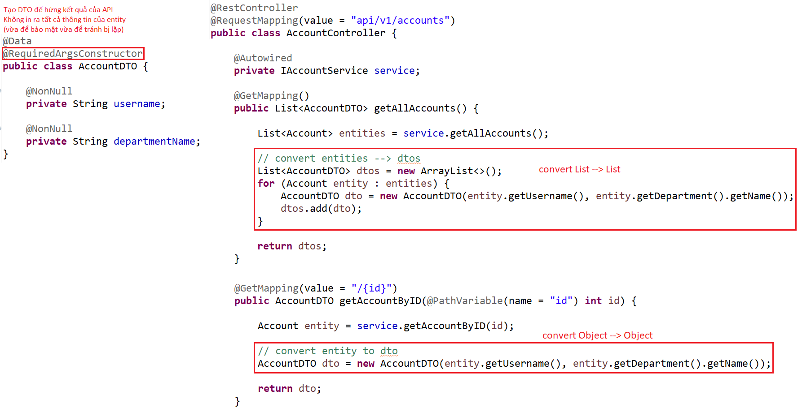
ModelMapper
  Fix by DTO
DTO & Controller

Slide 9
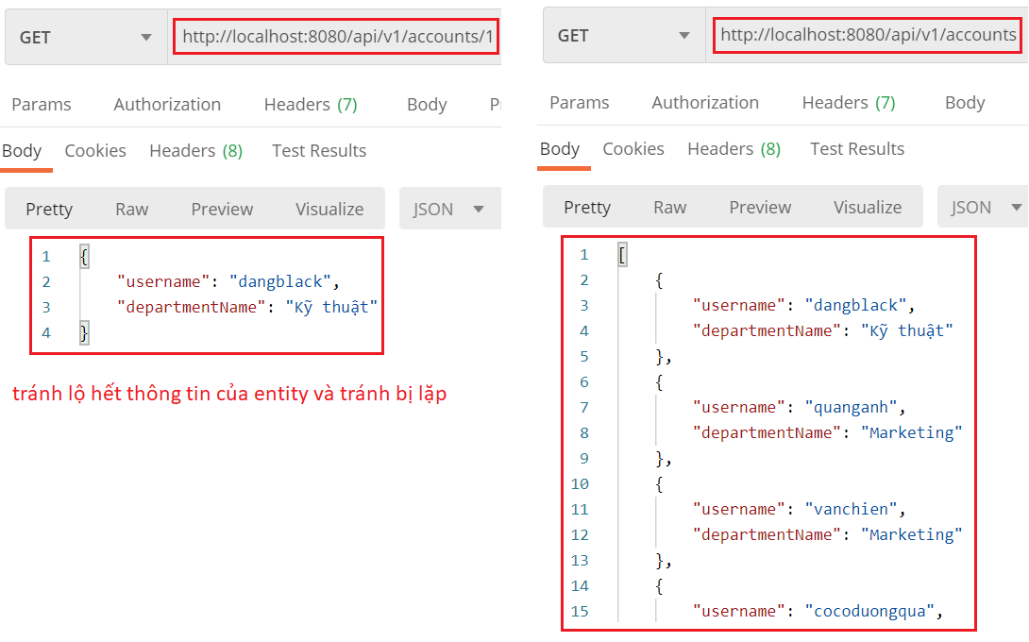
ModelMapper
Test

Slide 10
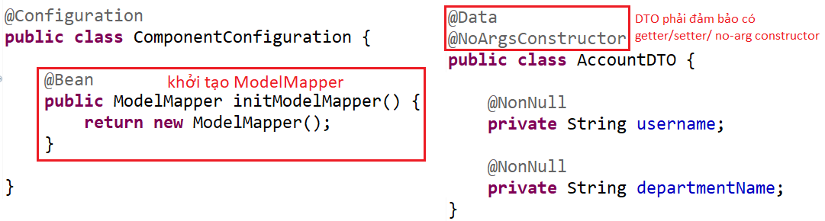
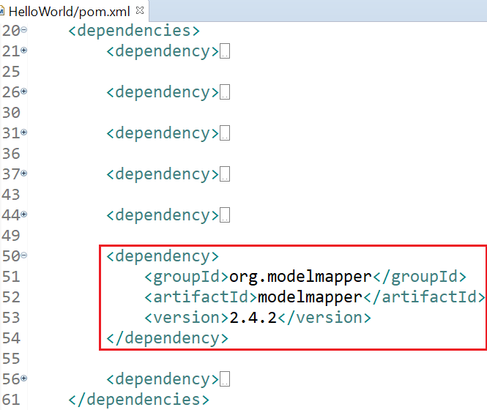
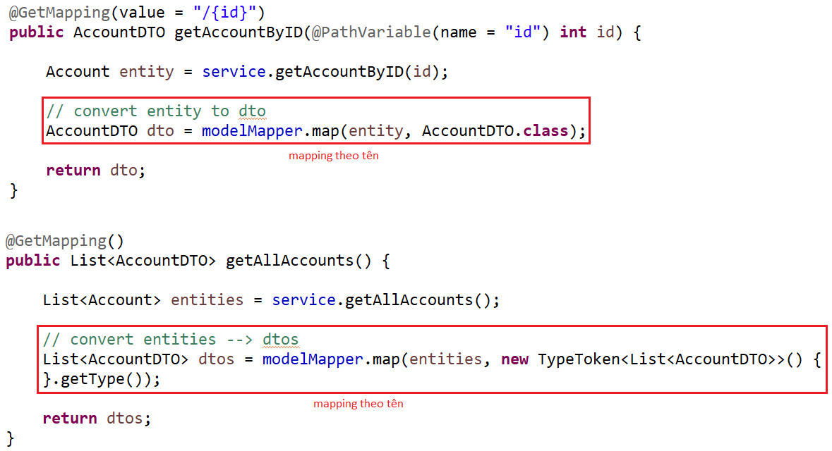
ModelMapper
  Fix by ModelMapper
http://modelmapper.org/getting-started/
DTO & Controller

Slide 11
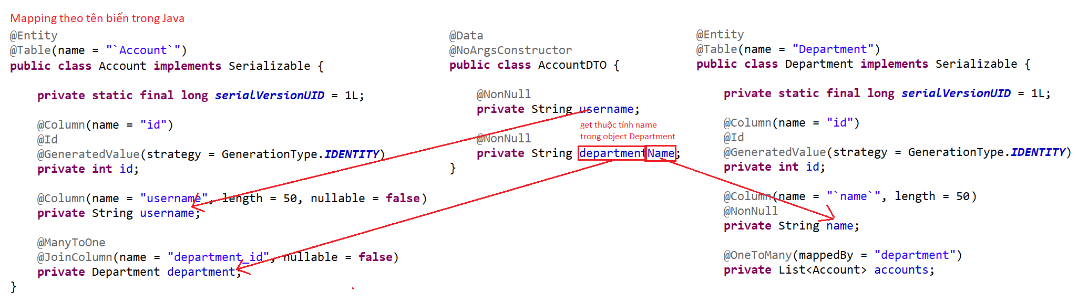
ModelMapper
Mapping Entity & DTO

Slide 12
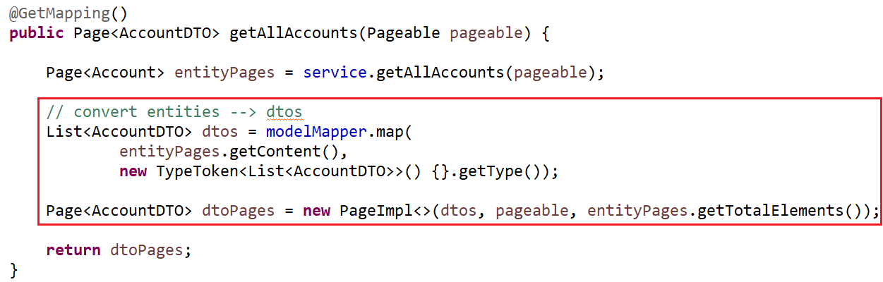
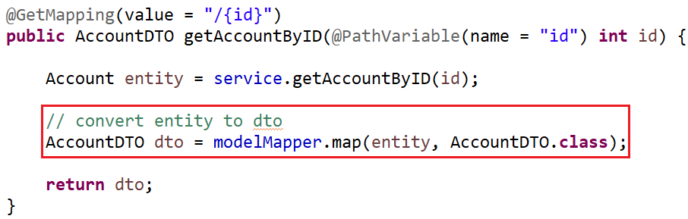
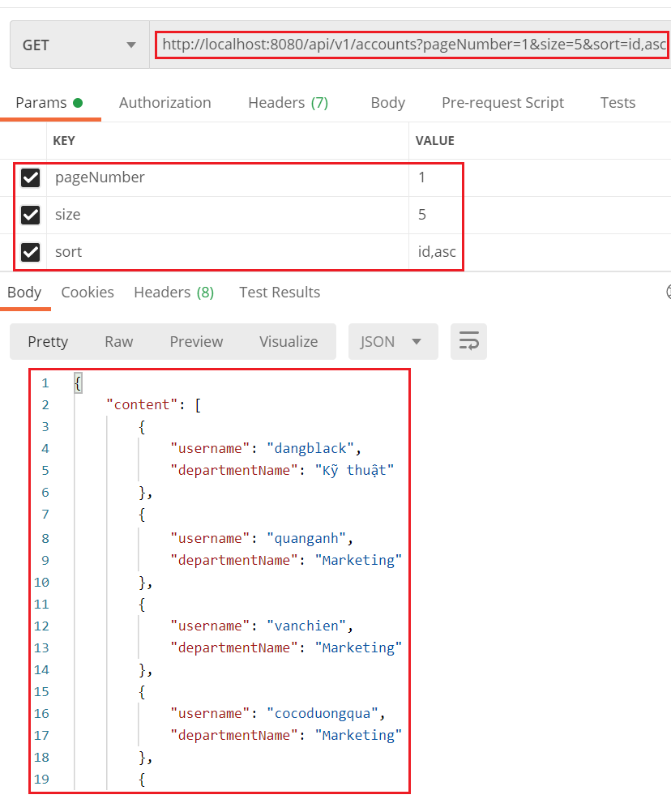
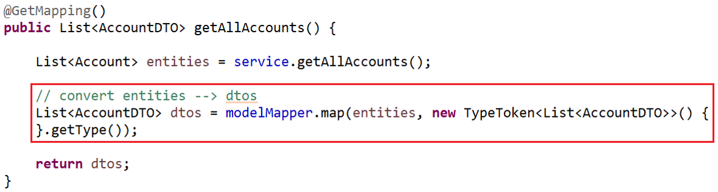
ModelMapper
Summary
Convert Object to Object
Convert List to List
Convert Page to Page

Slide 13
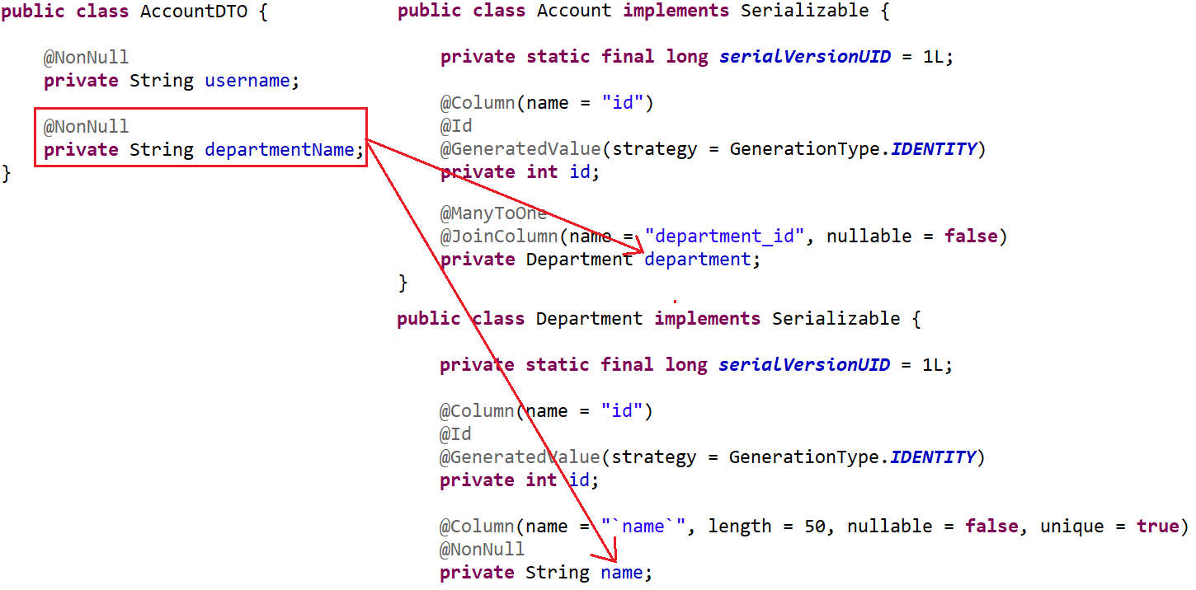
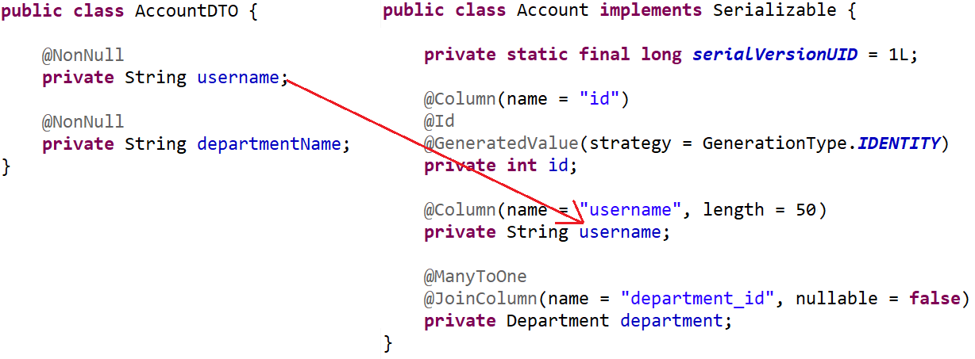
ModelMapper
Mapping
Mapping Attribute
Mapping Nested Attribute

Slide 14
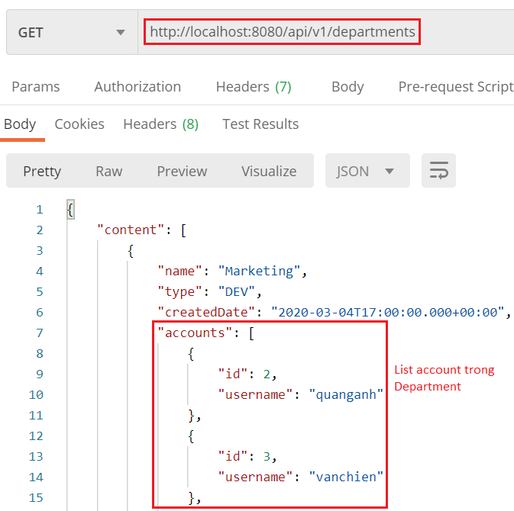
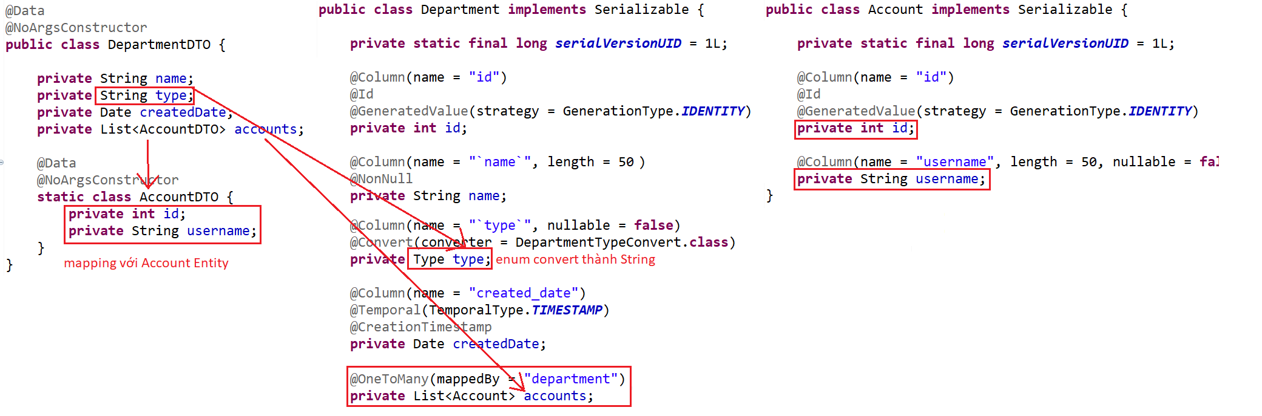
ModelMapper
Mapping List

Slide 15
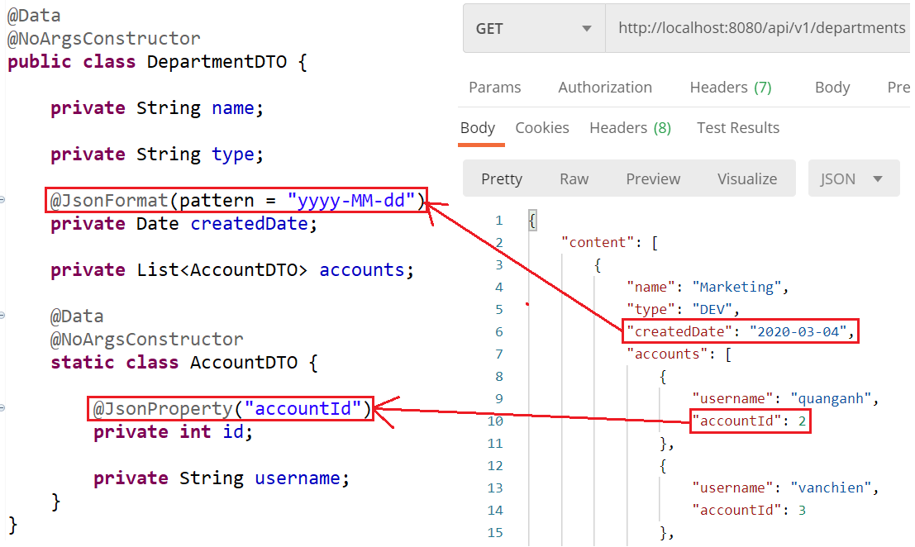
ModelMapper
Formatting DTO
Date & Rename

Slide 16
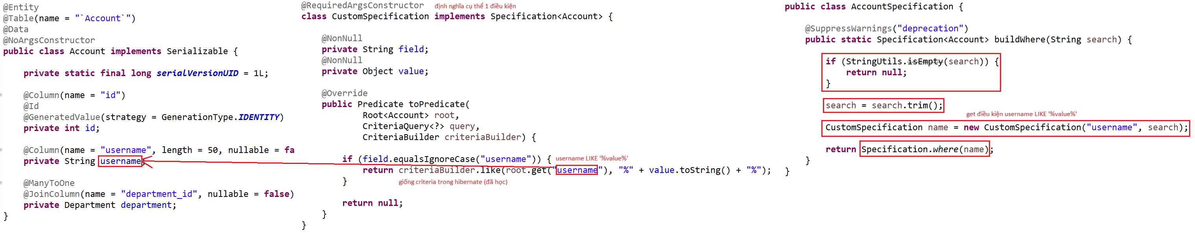
Spring Data
Specification
  Used to build where conditions for the query
Example 1: 1 condition
Entity & Specification
WHERE username LIKE ‘‘%value%

Slide 17
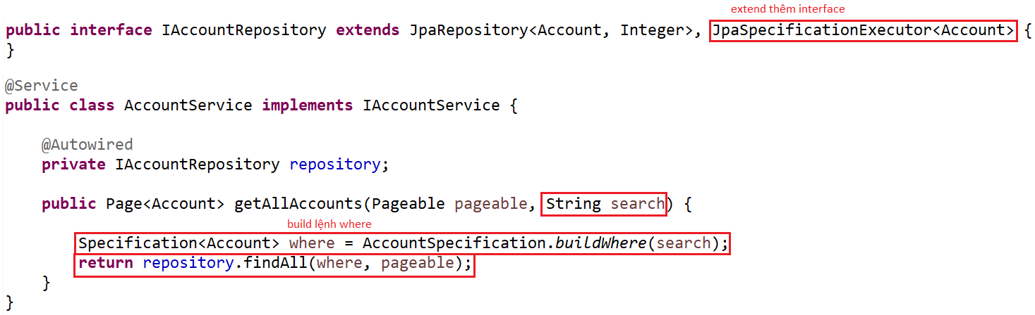
Spring Data
Repository & Service

Slide 18
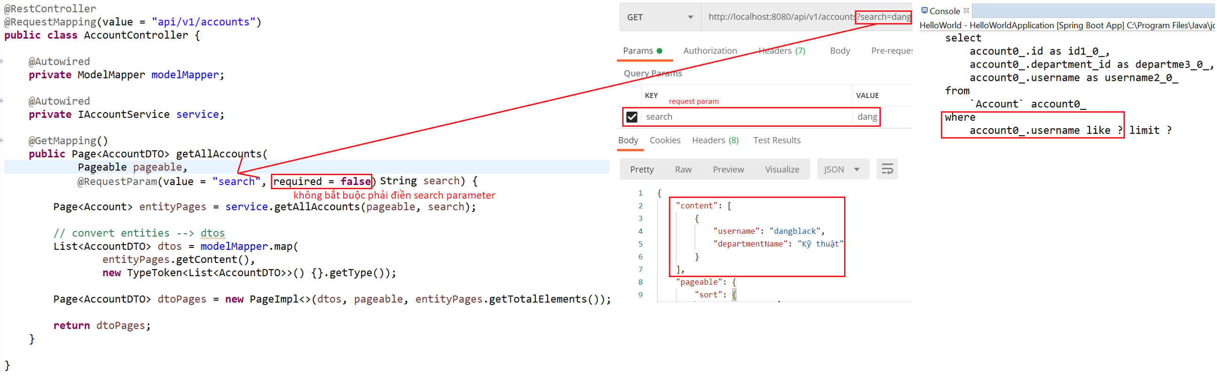
Spring Data
Controller & Test

Slide 19
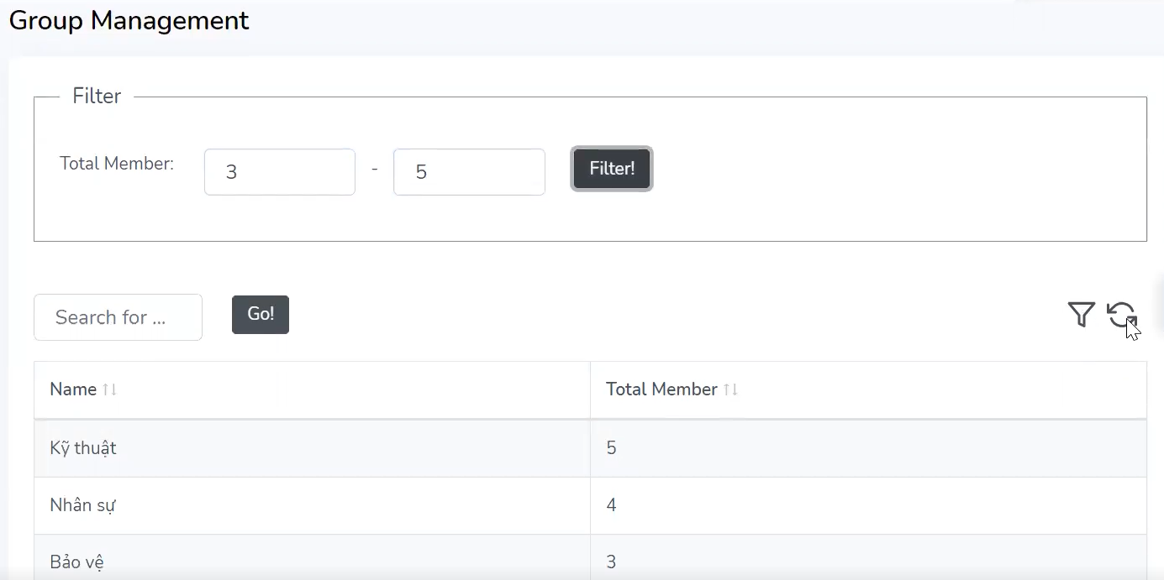
Spring Data
Example 2: multiple condition

Slide 20
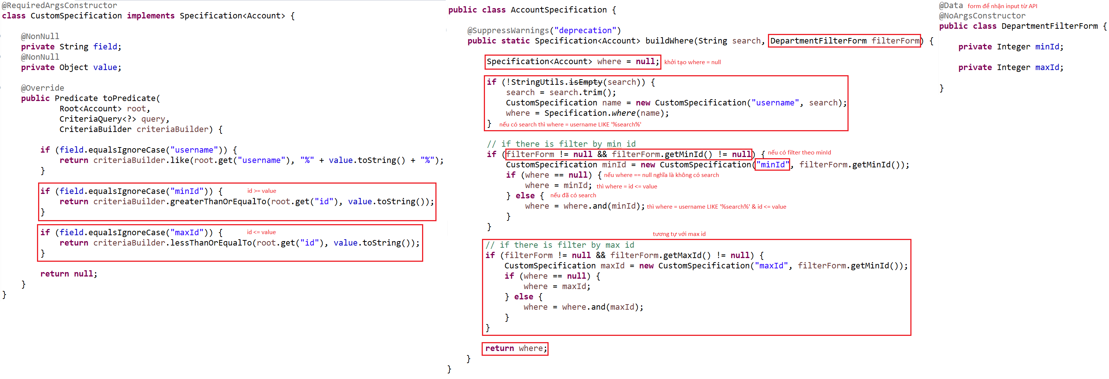
Spring Data
Specification

Slide 21
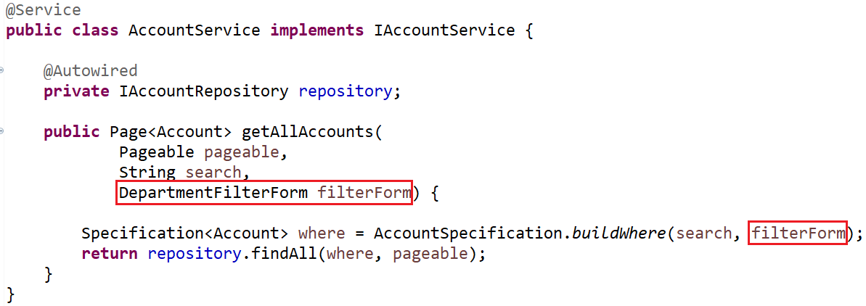
Spring Data
Service

Slide 22
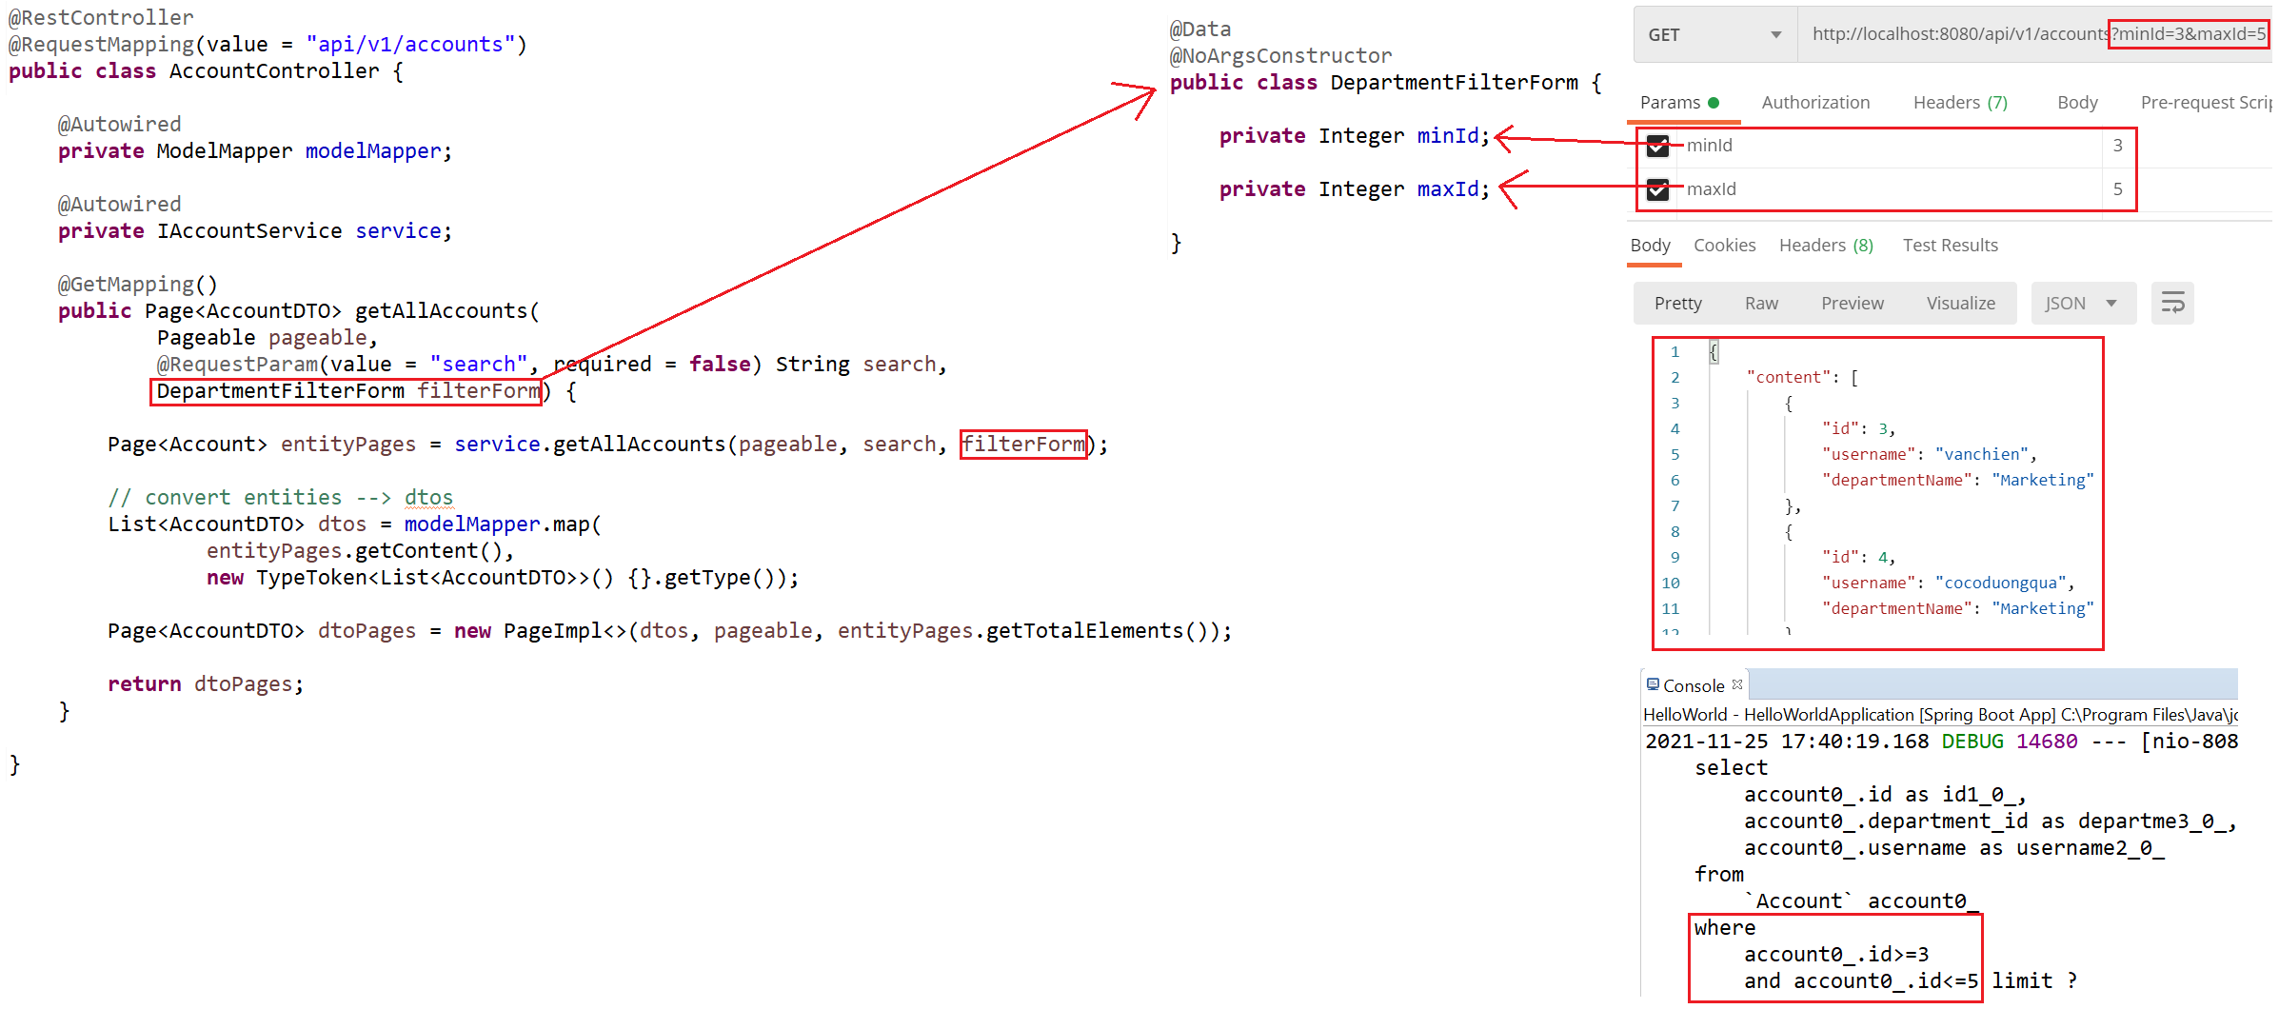
Spring Data
Test

Slide 23
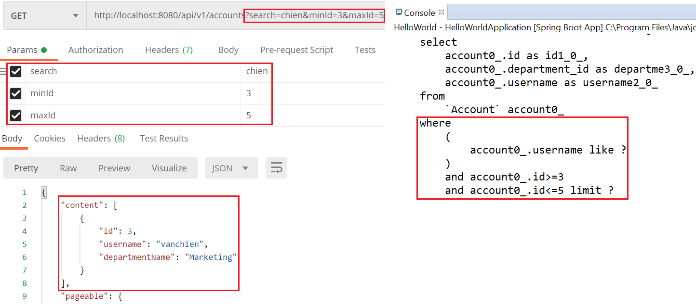
Spring Data
Test

Slide 24
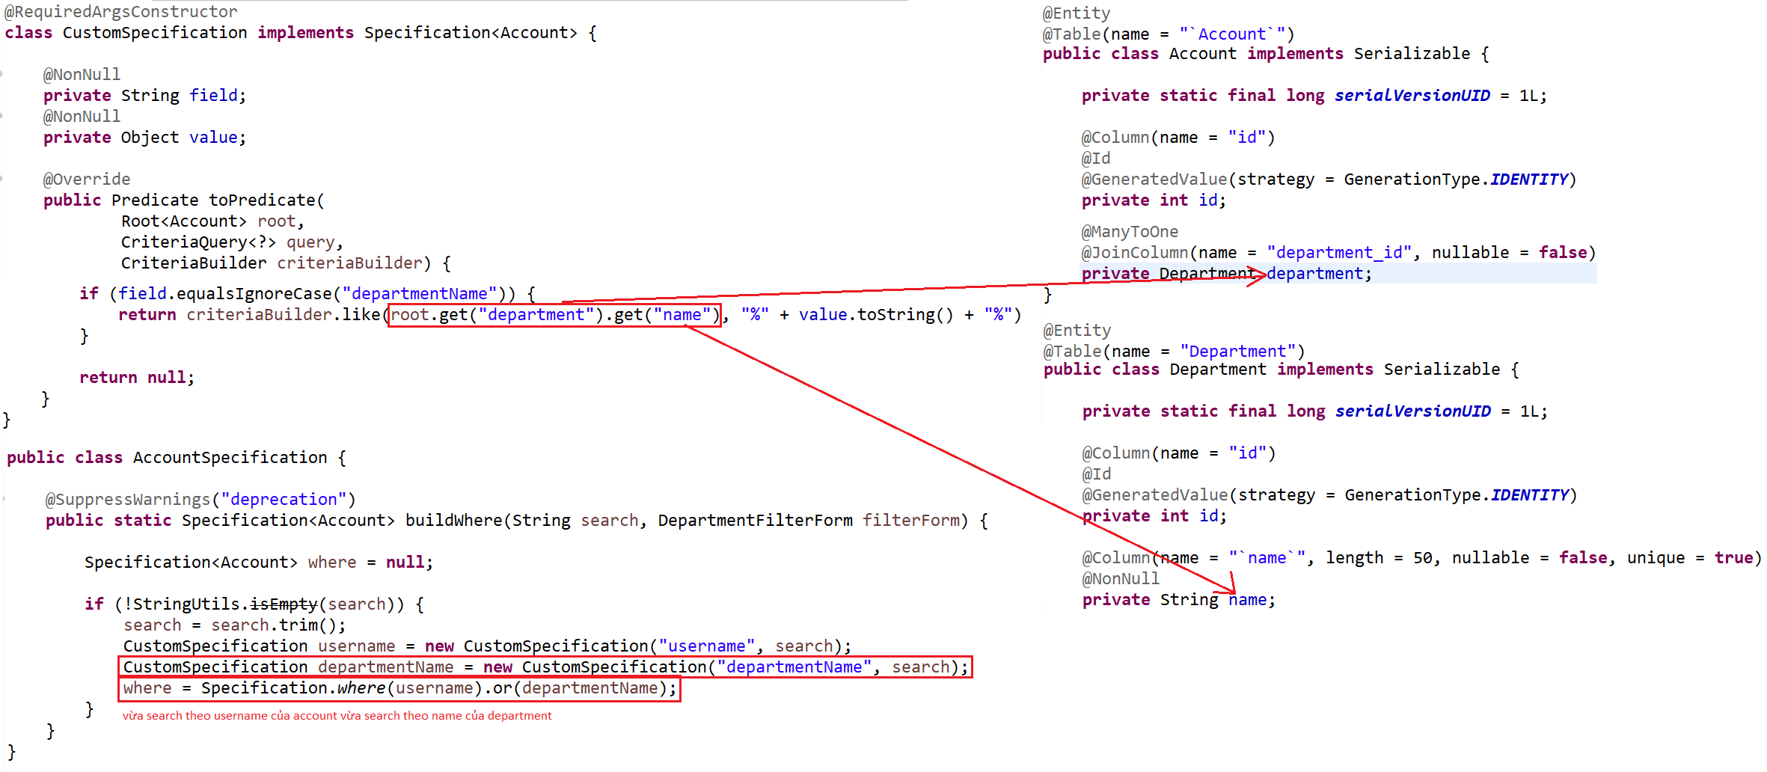
Spring Data
Example 3: Nested Attribute
  Object
Specification & Entity

Slide 25
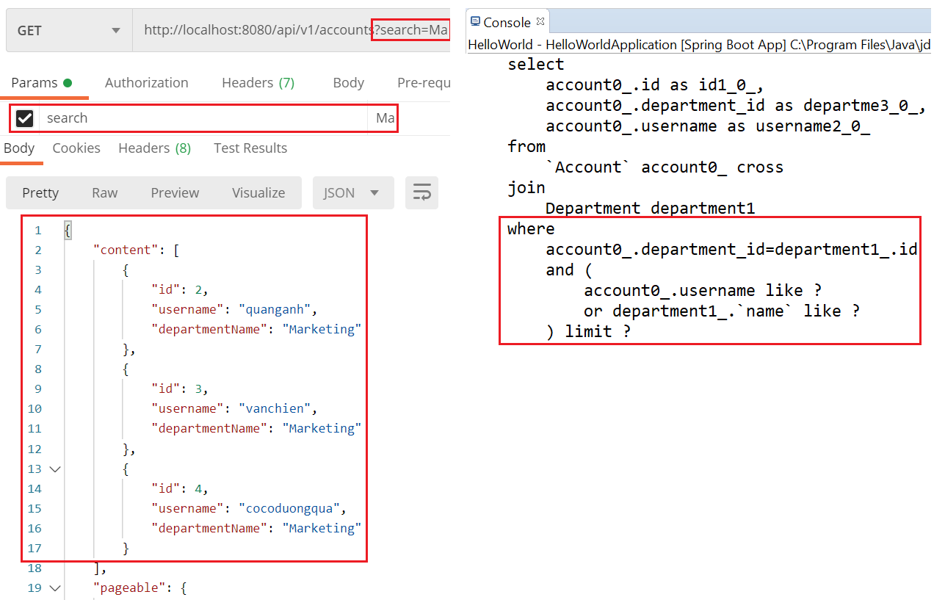
Spring Data
Test

Slide 26
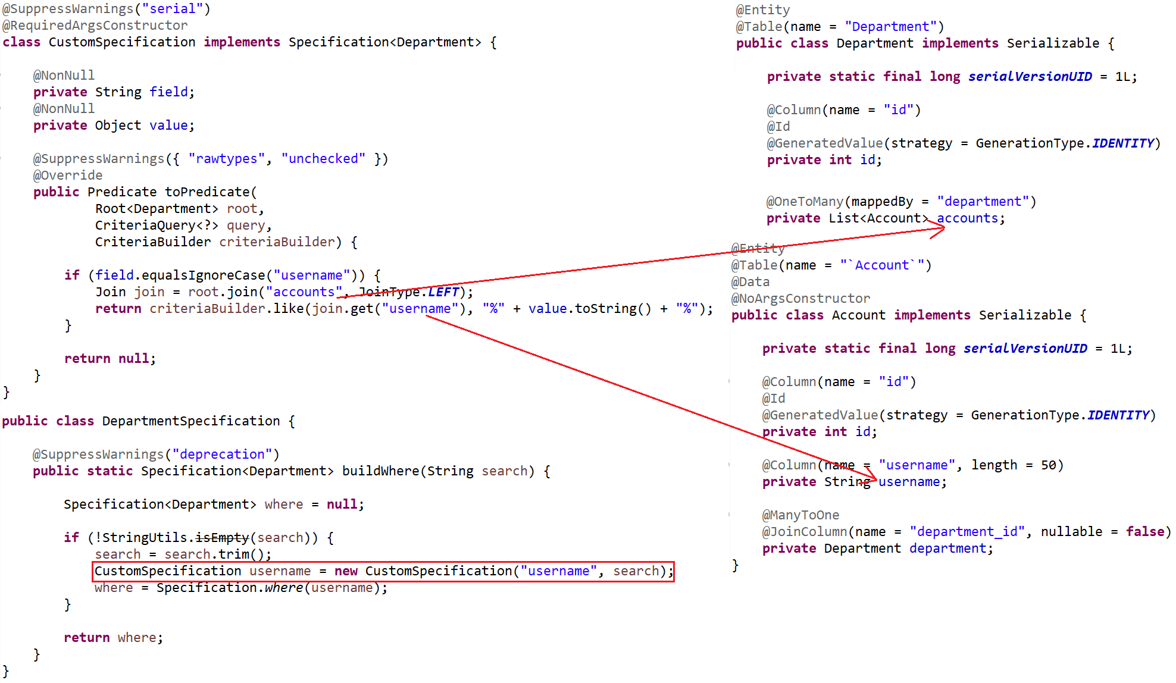
Spring Data
  List
Specification & Entity

Slide 27
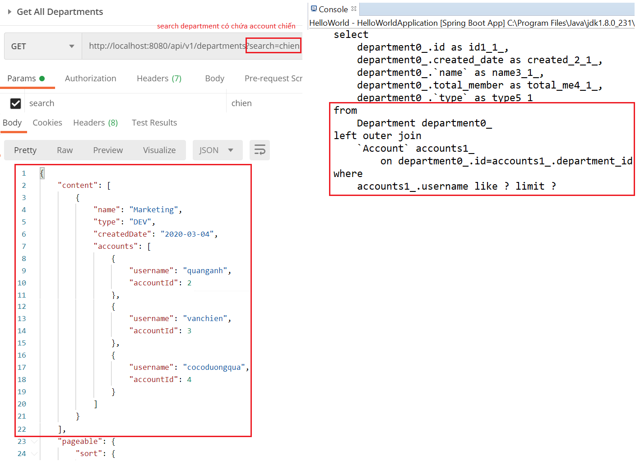
Spring Data
Test

Slide 28
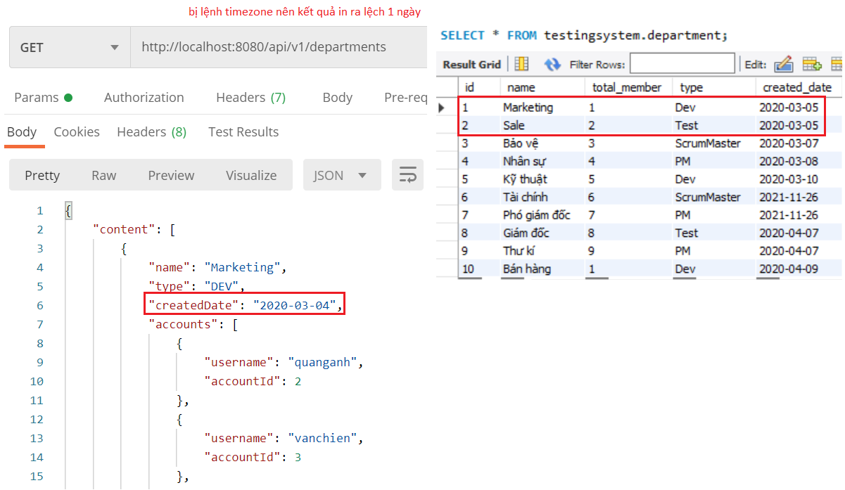
Spring Data
Example 4: Date
  Problem

Slide 29
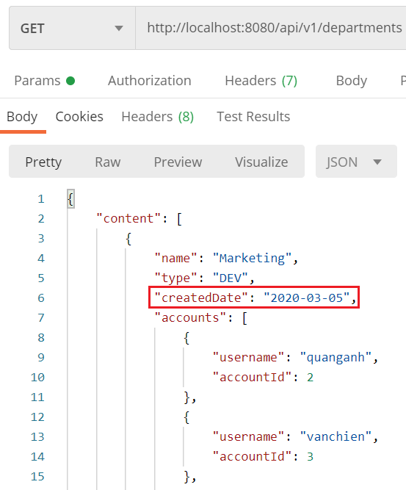
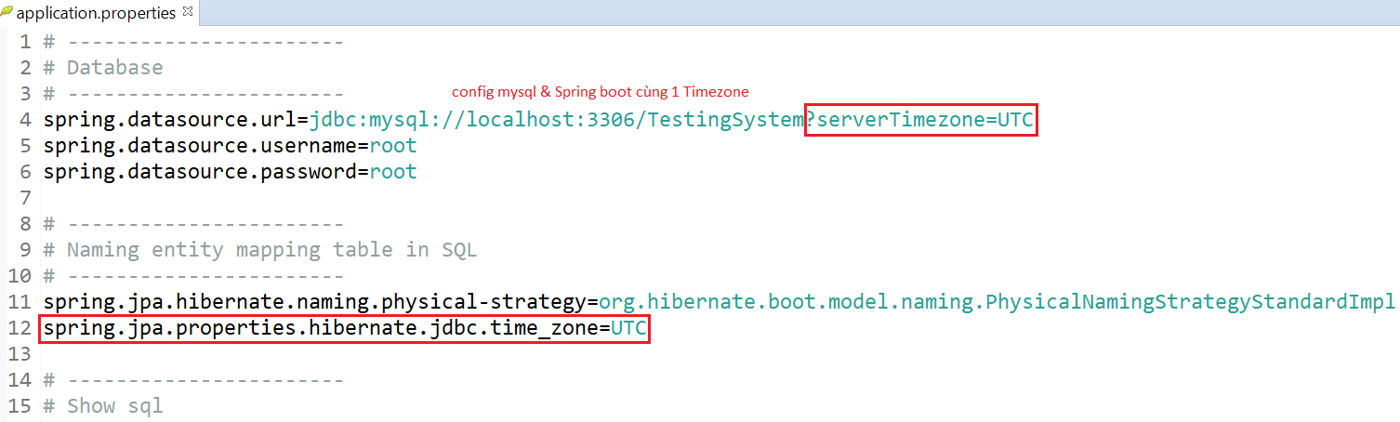
Spring Data
  Fix

Slide 30
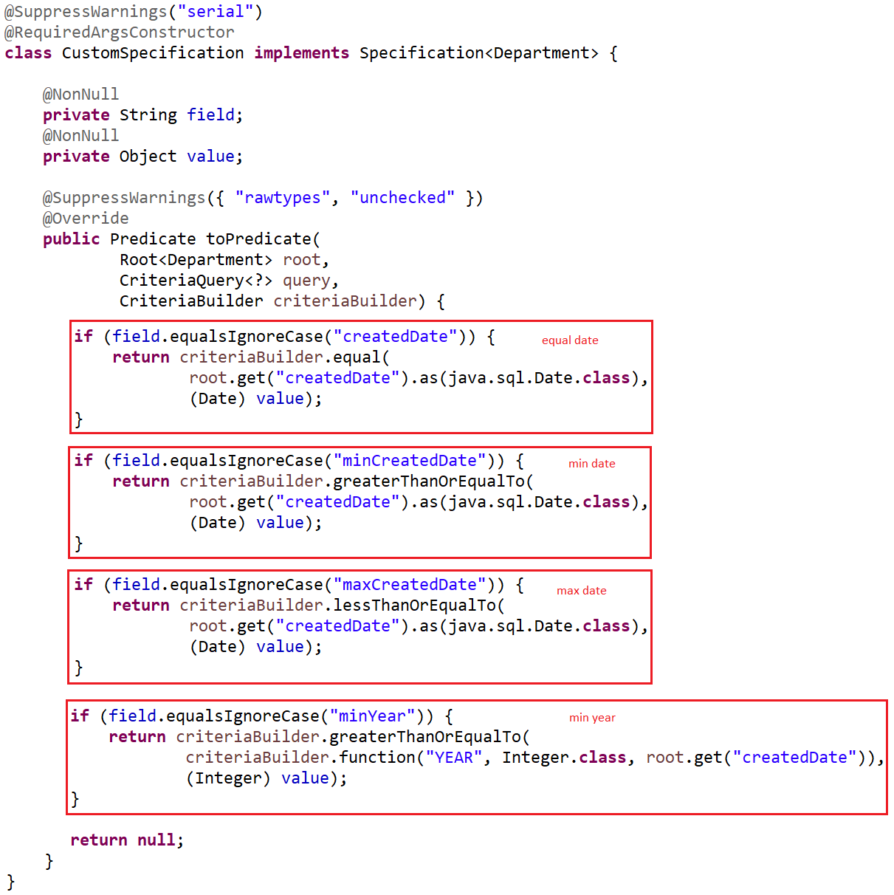
Spring Data
  Compare Date: Equal Date, MinDate, MaxDate, MinYear, ...
Specification

Slide 31
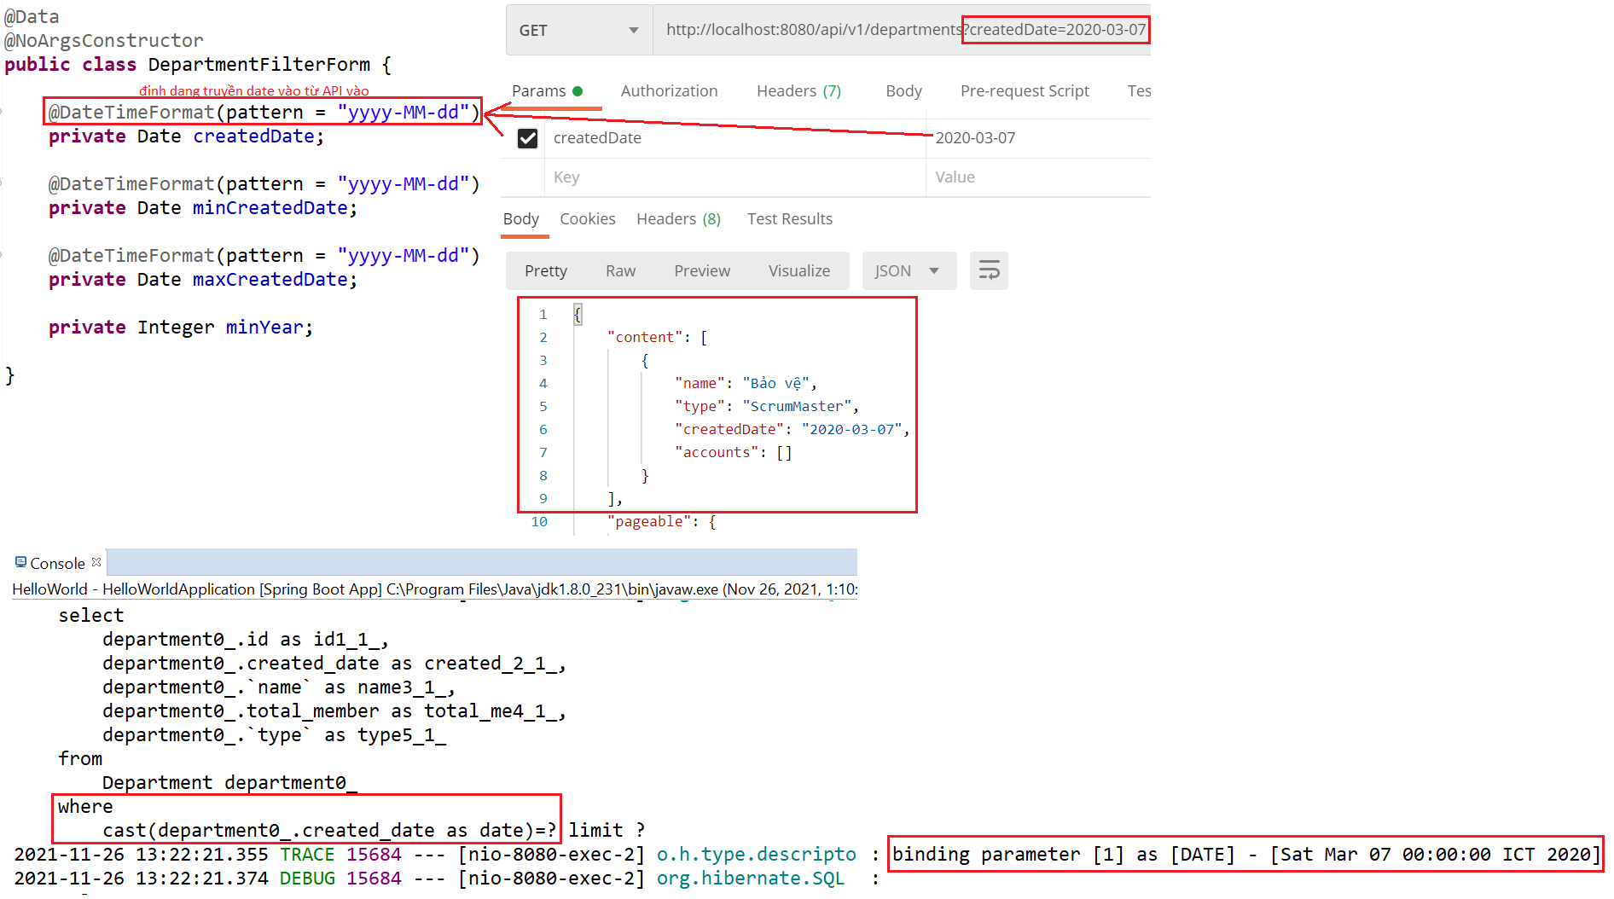
Spring Data
Test equal Date

Slide 32
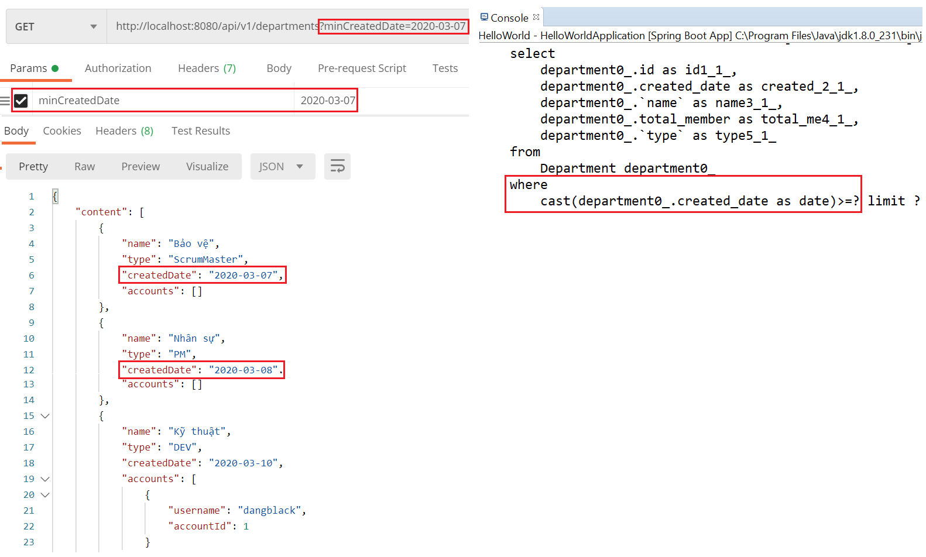
Spring Data
Test min & max Date

Slide 33
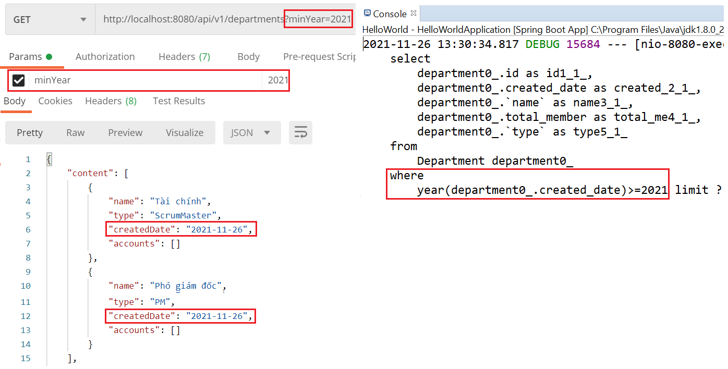
Spring Data
Test min year

Slide 34
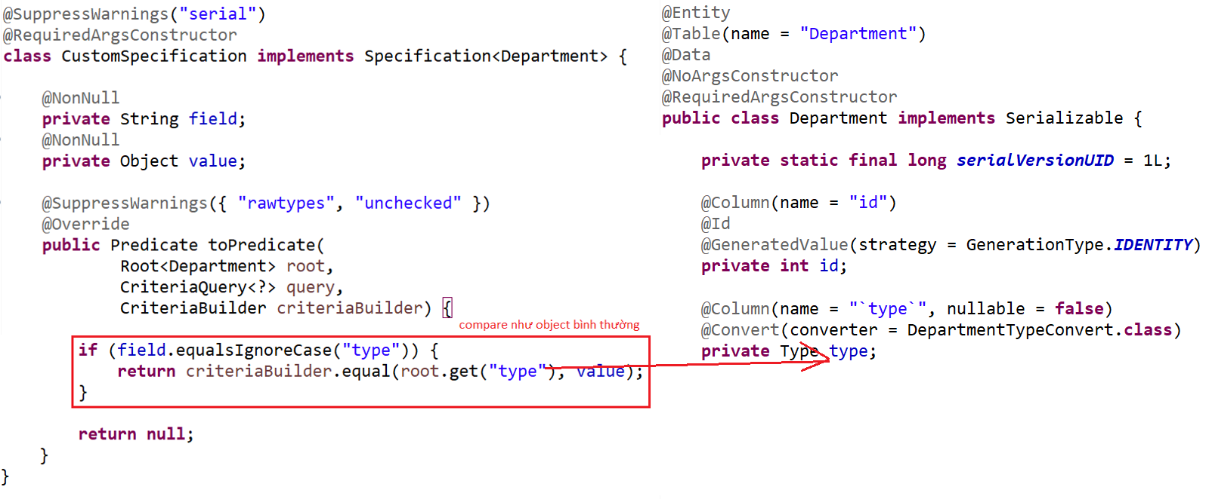
Spring Data
Example 5: Enum
Specification & Entity

Slide 35
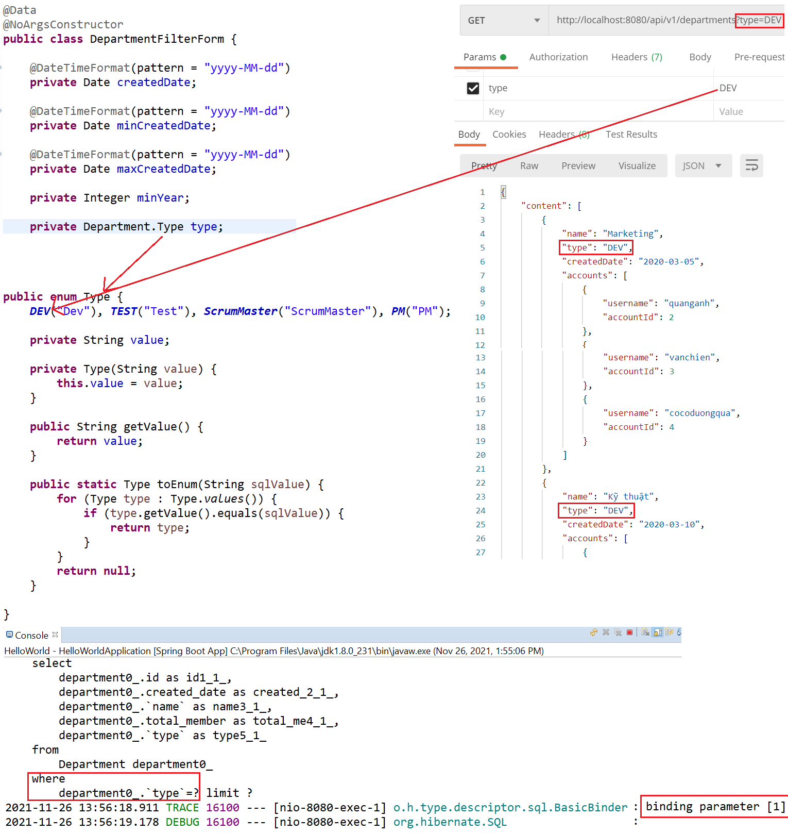
Spring Data
Test

Slide 36
Q & A
Copyright © VTI Academy All Rights Reserved

